Slide 1
APK Generation
Screen Shots
ABM1 — C196 — Mobile Application Development

Slide 2
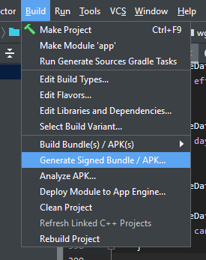
Menu Option Selection

Slide 3
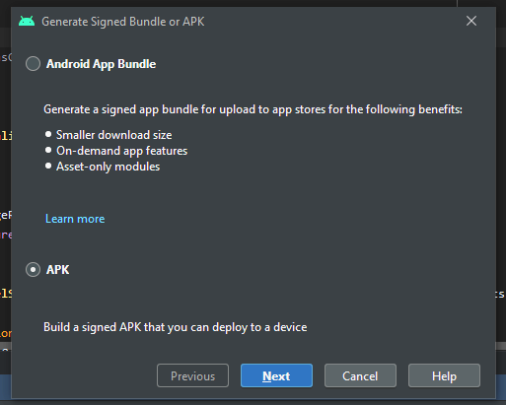
Select APK

Slide 4
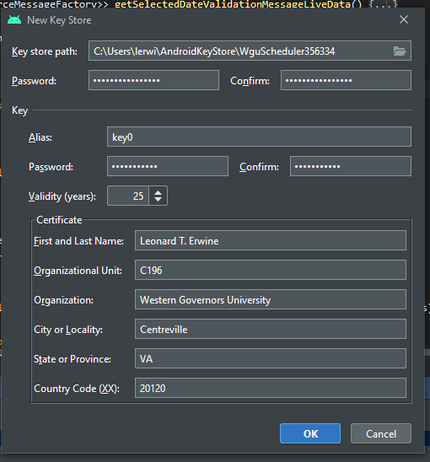
Set up key store

Slide 5
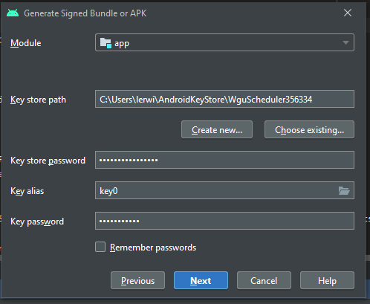
Select Module

Slide 6
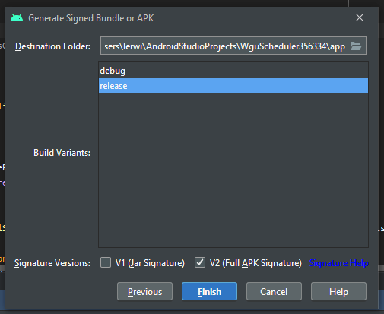
Select destination folder and release

Slide 7
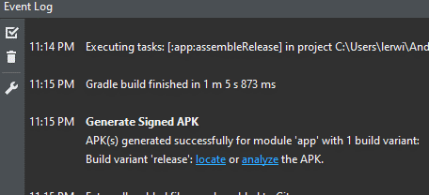
Event log showing success

